Slide 1
ONLINE CLASS
GRAPH THEORY
BICTE $6^{TH}$ SEMESTER
2078/02/19
PRESENTED BY KALYAN DAHAL

Slide 2
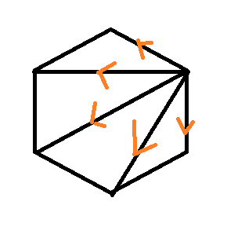


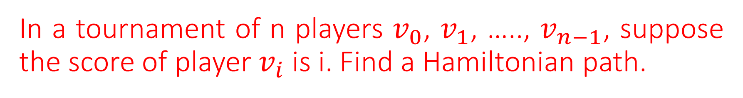



In a tournament of n players $v_{0}$, $v_{1}$, ….., $v_{n−1}$, suppose the score of player $v_{i}$ is i. Find a Hamiltonian path.
Solution: since $v_{n−1}$ wins n – 1 games, implies $v_{n−1}$ defeats all the other players. So $v_{n−1}$ defeats to $v_{n−2}$. There is an outgoing edge from $v_{n−1}$ to $v_{n−2}$. Similarly there is an outgoing edge from $v_{n−2}$ to $v_{n−3}$ and so on and finally there is an outgoing edge from $v_{1}$ to $v_{0}$.
Thus, $v_{0}$ $→$ $v_{1}$ $→$ ……… $→$ $v_{n−2}$ $→ v_{n−1}$ is a Hamiltonian path of a tournament with n players.
$$v_{0}$$
$$v_{1}$$
$$v_{n−1}$$
$$v_{n−2}$$

Slide 3
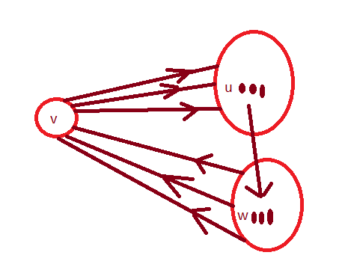



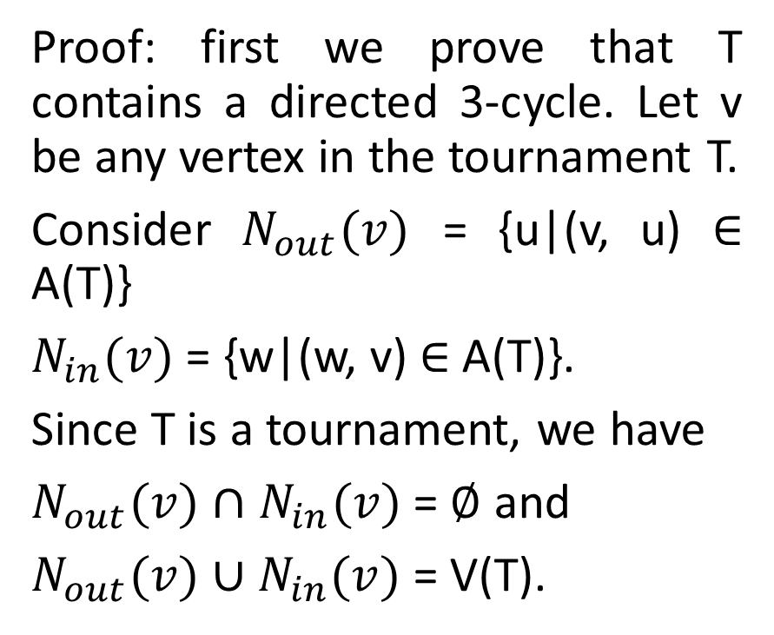
Every strongly connected tournament T(p $≥$ 3) vertices contains a directed cycle of length 3, 4, 5, … , p.
Proof: first we prove that T contains a directed 3-cycle. Let v be any vertex in the tournament T.
Consider $N_{out}(v)$ = {u|(v, u) $∈$ A(T)}
$N_{in}(v)$ = {w|(w, v) $∈$ A(T)}.
Since T is a tournament, we have
$N_{out}(v)$ $∩$ $N_{in}(v)$ = $∅$ and
$N_{out}(v)$ $∪N_{in}(v)$ = V(T).
$N_{out}(v)$
$N_{in}(v)$

Slide 4
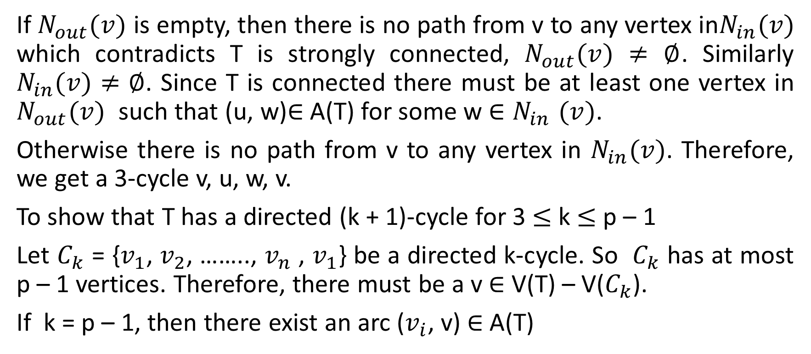
Continued…..
If $N_{out}(v)$ is empty, then there is no path from v to any vertex in$N_{in}(v)$ which contradicts T is strongly connected, $N_{out}(v)$ $≠$ $∅$. Similarly $N_{in}(v)$ $≠$ $∅$. Since T is connected there must be at least one vertex in $N_{out}(v)$ such that (u, w)$∈$ A(T) for some w ${∈N}_{in}(v)$.
Otherwise there is no path from v to any vertex in $N_{in}(v)$. Therefore, we get a 3-cycle v, u, w, v.
To show that T has a directed (k + 1)-cycle for 3 $≤$ k $≤$ p – 1
Let $C_{k}$ = {$v_{1}$, $v_{2}$, …….., $v_{n}$ , $v_{1}$} be a directed k-cycle. So $C_{k}$ has at most p – 1 vertices. Therefore, there must be a v $∈$ V(T) – V($C_{k}$).
If k = p – 1, then there exist an arc ($v_{i}$, v) $∈$ A(T)

Slide 5
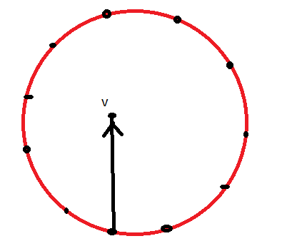


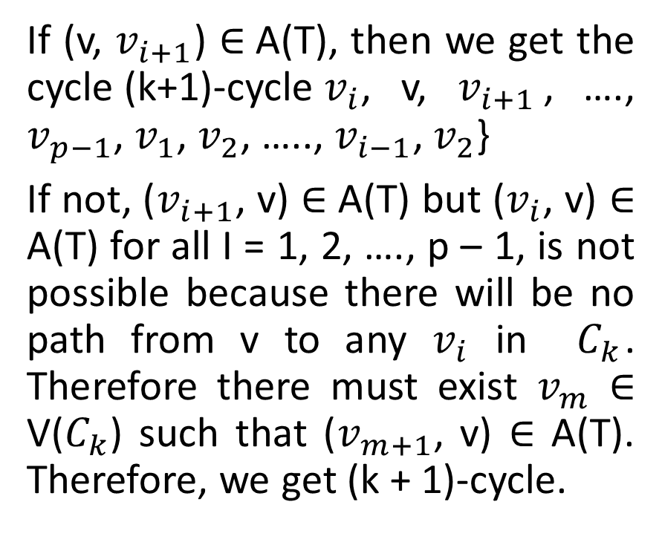




Continued……
$$v_{1}$$
$$v_{1}$$
$$v_{2}$$
If (v, $v_{i+1}$) $∈$A(T), then we get the cycle (k+1)-cycle $v_{i}$ , v, $v_{i+1}$, …., $v_{p−1}$, $v_{1}$, $v_{2}$, ….., $v_{i−1}$, $v_{2}$}
If not, ($v_{i+1}$, v) $∈$ A(T) but ($v_{i}$, v) $∈$ A(T) for all I = 1, 2, …., p – 1, is not possible because there will be no path from v to any $v_{i}$ in $C_{k}$. Therefore there must exist $v_{m}$ $∈$ V($C_{k}$) such that ($v_{m+1}$, v) $∈$ A(T). Therefore, we get (k + 1)-cycle.
$$v_{k}$$
$$v_{k}$$
$$v_{3}$$

Slide 6
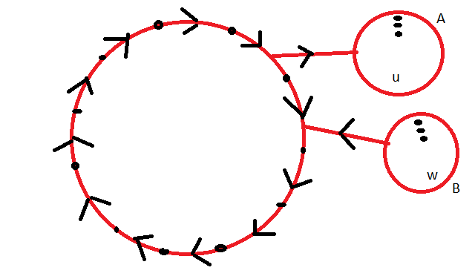
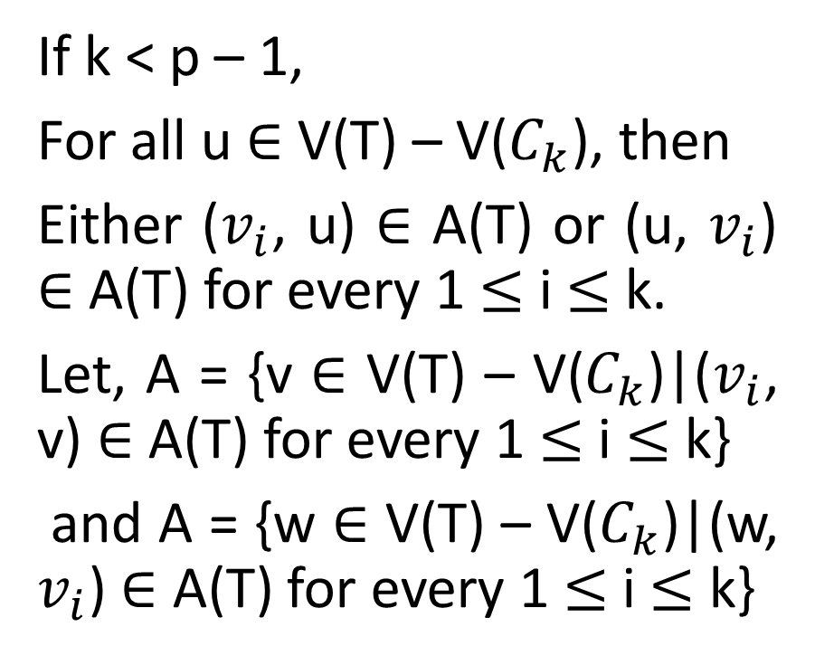




Continued……
If k < p – 1,
For all u $∈$ V(T) – V($C_{k}$), then
Either ($v_{i}$, u) $∈$ A(T) or (u, $v_{i}$) $∈$ A(T) for every 1 $≤$ i $≤$ k.
Let, A = {v $∈$ V(T) – V($C_{k}$)|($v_{i}$, v) $∈$ A(T) for every 1 $≤$ i $≤$ k}
and A = {w $∈$ V(T) – V($C_{k}$)|(w, $v_{i}$) $∈$ A(T) for every 1 $≤$ i $≤$ k}
$$v_{k}$$
$$v_{1}$$
$$v_{2}$$
$$v_{3}$$

Slide 7
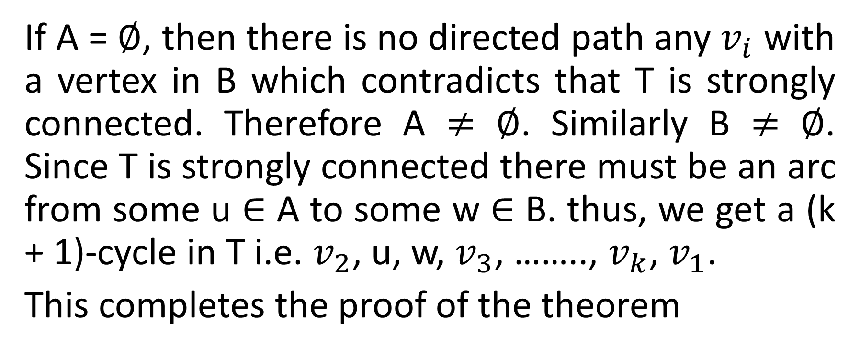
Continued…..
If A = $∅$, then there is no directed path any $v_{i}$ with a vertex in B which contradicts that T is strongly connected. Therefore A $≠$ $∅$. Similarly B $≠$ $∅$. Since T is strongly connected there must be an arc from some u $∈$ A to some w $∈$ B. thus, we get a (k + 1)-cycle in T i.e. $v_{2}$, u, w, $v_{3}$, …….., $v_{k}$, $v_{1}$.
This completes the proof of the theorem

Slide 8
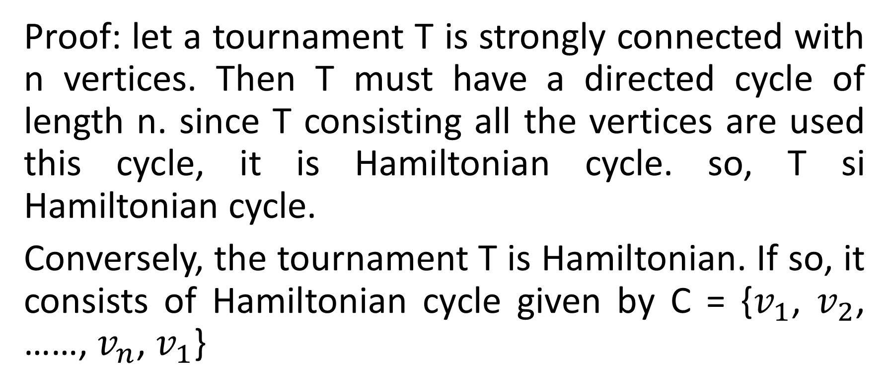
A tournament T is Hamiltonian iff it is strongly connected.
Proof: let a tournament T is strongly connected with n vertices. Then T must have a directed cycle of length n. since T consisting all the vertices are used this cycle, it is Hamiltonian cycle. so, T si Hamiltonian cycle.
Conversely, the tournament T is Hamiltonian. If so, it consists of Hamiltonian cycle given by C = {$v_{1}$, $v_{2}$, ……, $v_{n}$, $v_{1}$}

Slide 9
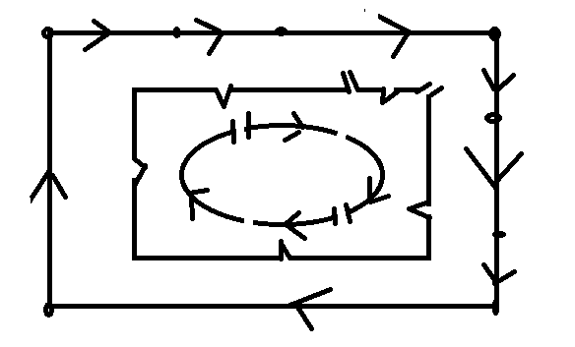





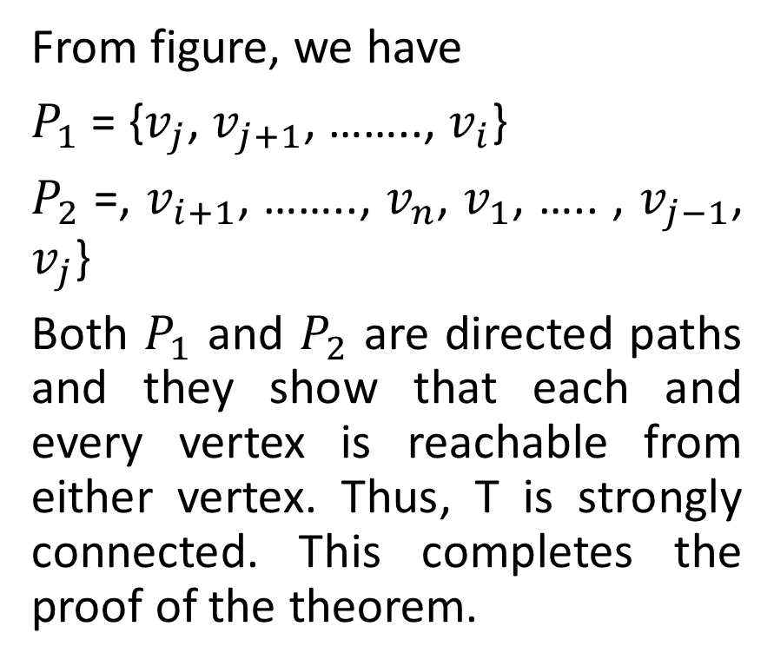





Continued…..
$$v_{j−1}$$
$$v_{2}$$
$$v_{j}$$
$$v_{j+1}$$
From figure, we have
$P_{1}$ = {$v_{j}$, $v_{j+1}$, …….., $v_{i}$}
$P_{2}$ =, $v_{i+1}$, …….., $v_{n}$, $v_{1}$, ….. , $v_{j−1}$, $v_{j}$}
Both $P_{1}$ and $P_{2}$ are directed paths and they show that each and every vertex is reachable from either vertex. Thus, T is strongly connected. This completes the proof of the theorem.
$$v_{i}$$
$$P_{1}$$
$$P_{2}$$
$v_{i+}$1
$$v_{1}$$
$$v_{n}$$

Slide 10
Traffic flow system
Strongly orientable:
An undirected graph is said to be strongly orientable if it is possible to assign an orientation (or direction) to each edge of G so that the resulting digraph is strongly connected.
Orientable:
A graph is orientable if it has strongly connected orientation.

Slide 11
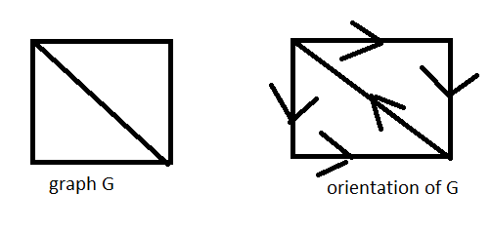
Continued….
A graph G and its Strongly orientation is shown below.

Slide 12
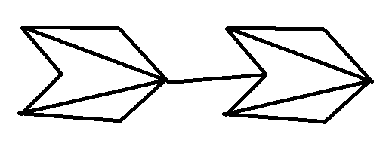


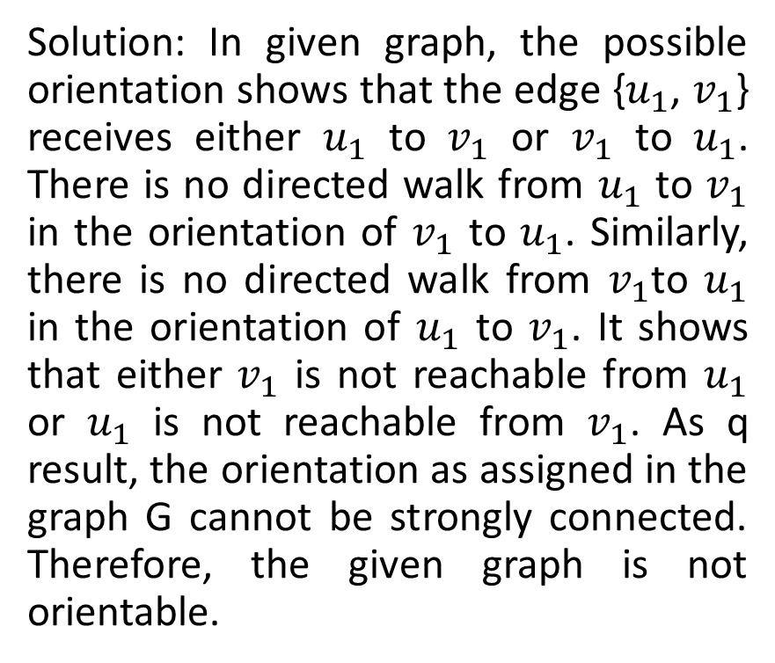










Examine whether the given graph is orientable or not.
Solution: In given graph, the possible orientation shows that the edge {$u_{1}$, $v_{1}$} receives either $u_{1}$ to $v_{1}$ or $v_{1}$ to $u_{1}$. There is no directed walk from $u_{1}$ to $v_{1}$ in the orientation of $v_{1}$ to $u_{1}$. Similarly, there is no directed walk from $v_{1}$to $u_{1}$ in the orientation of $u_{1}$ to $v_{1}$. It shows that either $v_{1}$ is not reachable from $u_{1}$ or $u_{1}$ is not reachable from $v_{1}$. As q result, the orientation as assigned in the graph G cannot be strongly connected. Therefore, the given graph is not orientable.
$$u_{3}$$
$$u_{2}$$
$$v_{2}$$
$$v_{3}$$
$$u_{4}$$
$$v_{1}$$
$$v_{4}$$
$$u_{1}$$
$$u_{5}$$
$$v_{6}$$
$$u_{6}$$
$$v_{5}$$

Slide 13
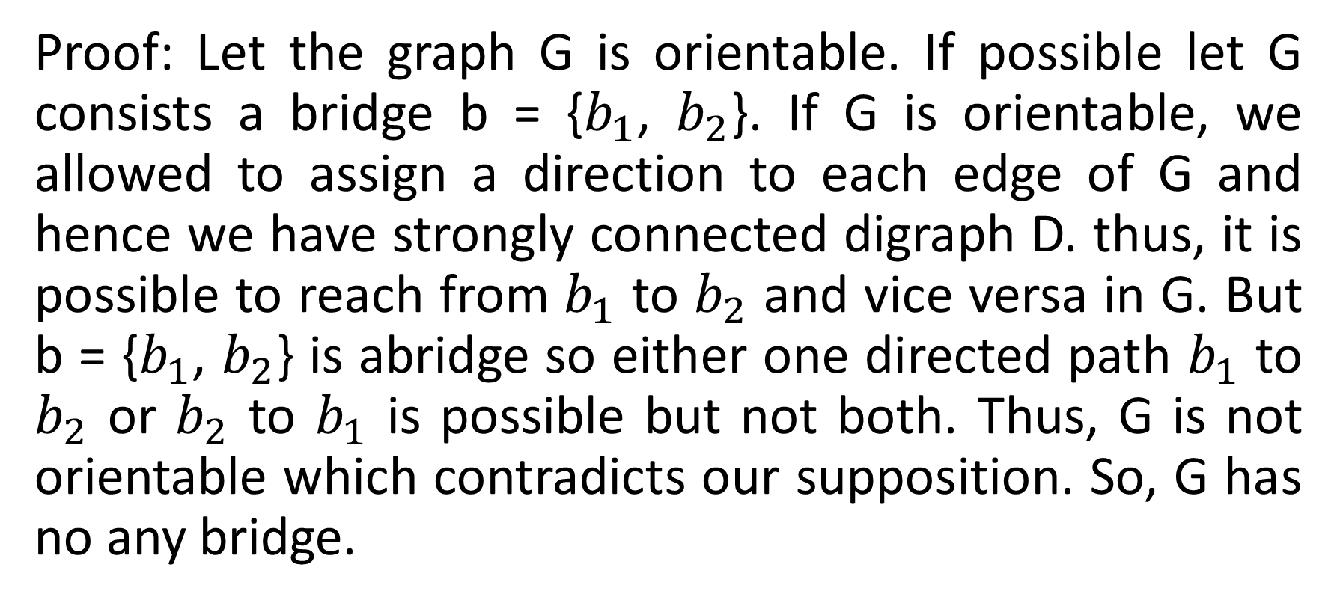
A connected graph G is orientable iff G contains no bridges.
Proof: Let the graph G is orientable. If possible let G consists a bridge b = {$b_{1}$, $b_{2}$}. If G is orientable, we allowed to assign a direction to each edge of G and hence we have strongly connected digraph D. thus, it is possible to reach from $b_{1}$ to $b_{2}$ and vice versa in G. But b = {$b_{1}$, $b_{2}$} is abridge so either one directed path $b_{1}$ to $b_{2}$ or $b_{2}$ to $b_{1}$ is possible but not both. Thus, G is not orientable which contradicts our supposition. So, G has no any bridge.

Slide 14
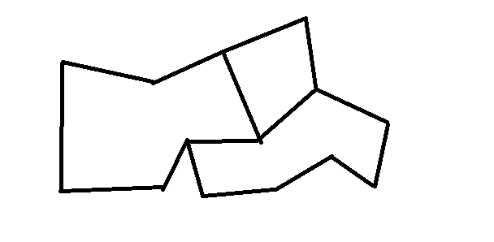








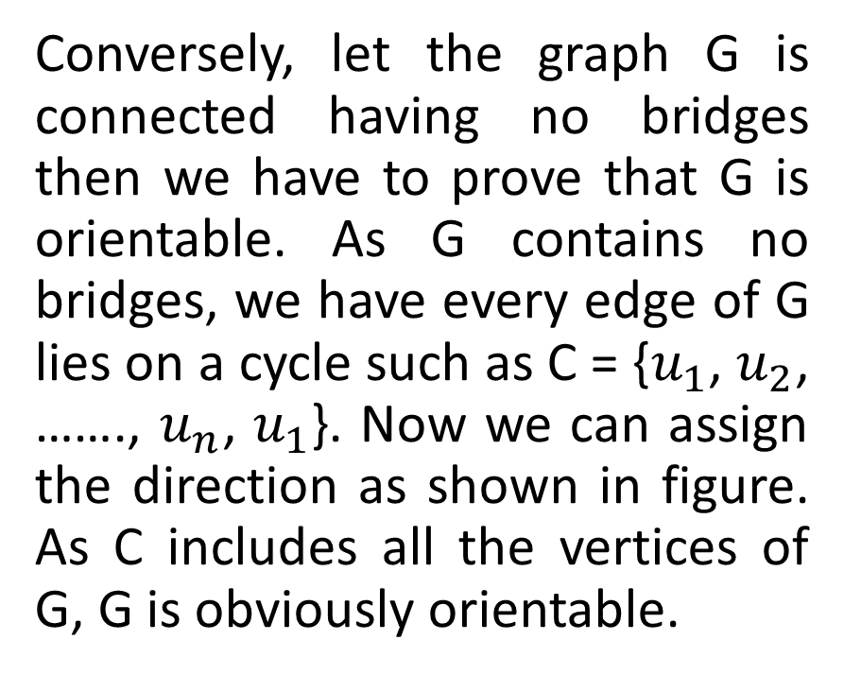

Continued…………
Conversely, let the graph G is connected having no bridges then we have to prove that G is orientable. As G contains no bridges, we have every edge of G lies on a cycle such as C = {$u_{1}$, $u_{2}$, ……., $u_{n}$, $u_{1}$}. Now we can assign the direction as shown in figure. As C includes all the vertices of G, G is obviously orientable.
$$v_{3}$$
$$u_{n}$$
$$v_{2}= u_{j}$$
$u_{3}$ = $v_{i+1}$
$$v_{1}$$
$$v_{i}$$
$$v_{m}$$
$$u_{1}$$
$$u_{2}$$

Slide 15
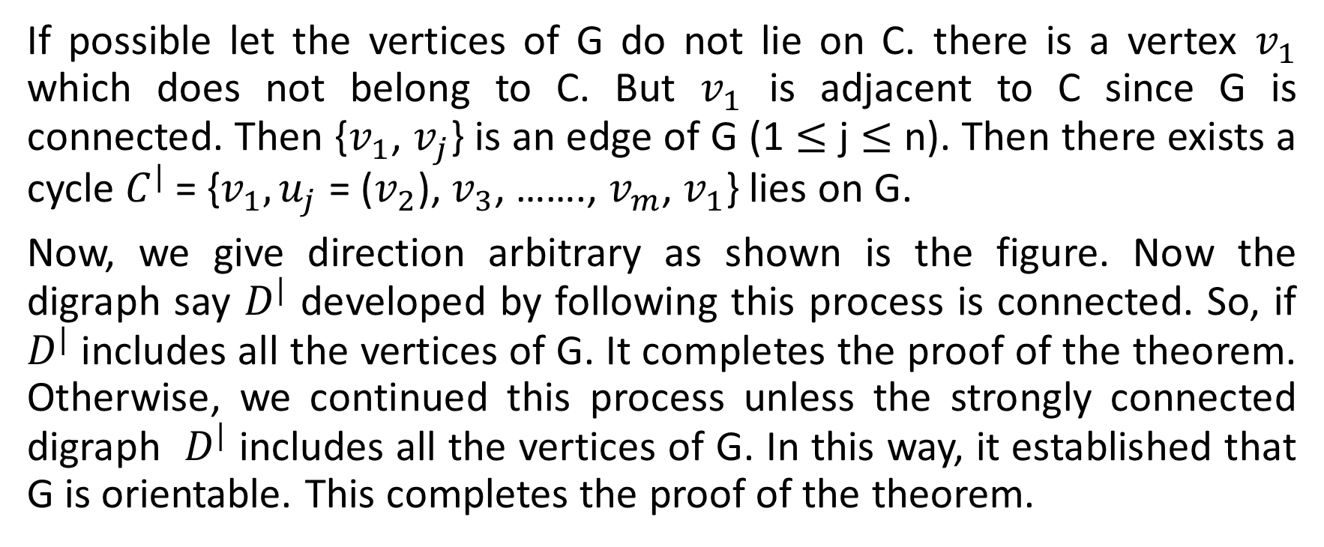
Continued…..
If possible let the vertices of G do not lie on C. there is a vertex $v_{1}$ which does not belong to C. But $v_{1}$ is adjacent to C since G is connected. Then {$v_{1}$, $v_{j}$} is an edge of G (1 $≤$ j $≤$ n). Then there exists a cycle $C^{|}$ = {$v_{1}, u_{j}$ = ($v_{2}$), $v_{3}$, ……., $v_{m}$, $v_{1}$} lies on G.
Now, we give direction arbitrary as shown is the figure. Now the digraph say $D^{|}$ developed by following this process is connected. So, if $D^{|}$ includes all the vertices of G. It completes the proof of the theorem. Otherwise, we continued this process unless the strongly connected digraph $D^{|}$ includes all the vertices of G. In this way, it established that G is orientable. This completes the proof of the theorem.

Slide 16


